Slide 1
UNIT- 2 WATER TANK

Slide 2
WATER TANK
BASED ON PLACEMENT OF TANK
BASED ON SHAPE OF TANK
1. RESTING ON GROUND
2. UNDER GROUND
3. ELEVATED
1. CIRCULAR
2. RECTANGULAR
3. SPHERICAL
4. INTZ
5. CONICAL BOTTOM

Slide 3
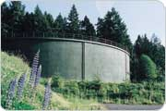
RESTING ON GROUND

Slide 4
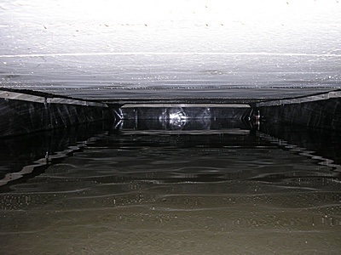
UNDERGROUND

Slide 5
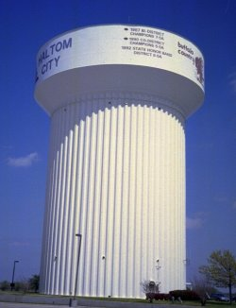
ELEVATED

Slide 6
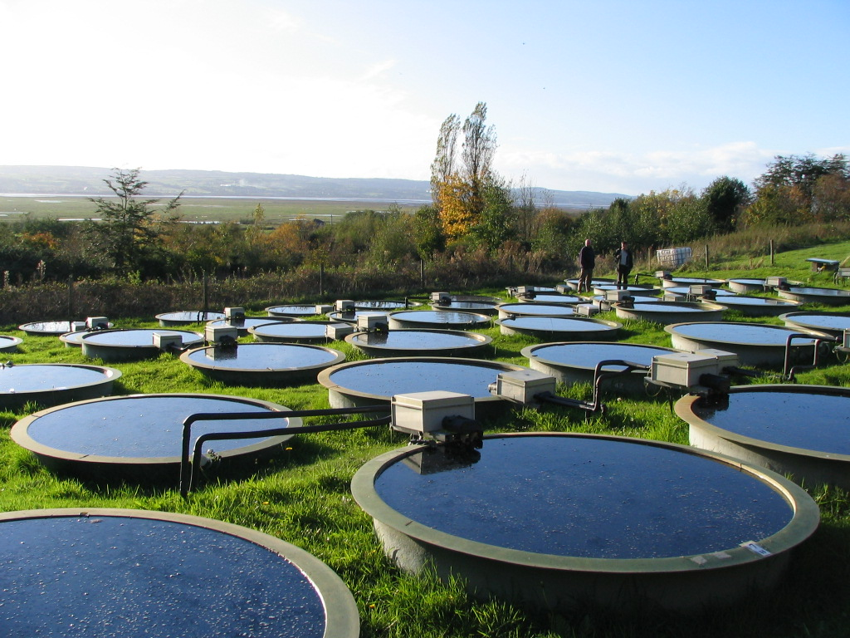
CIRCULAR

Slide 7
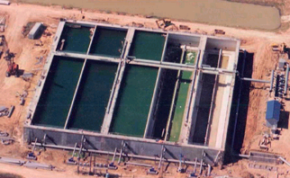
RECTANGULAR

Slide 8
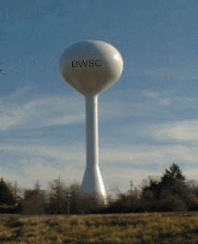
SPHERICAL

Slide 9
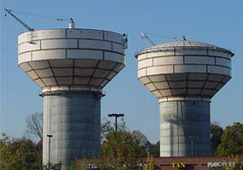
INTZ

Slide 10
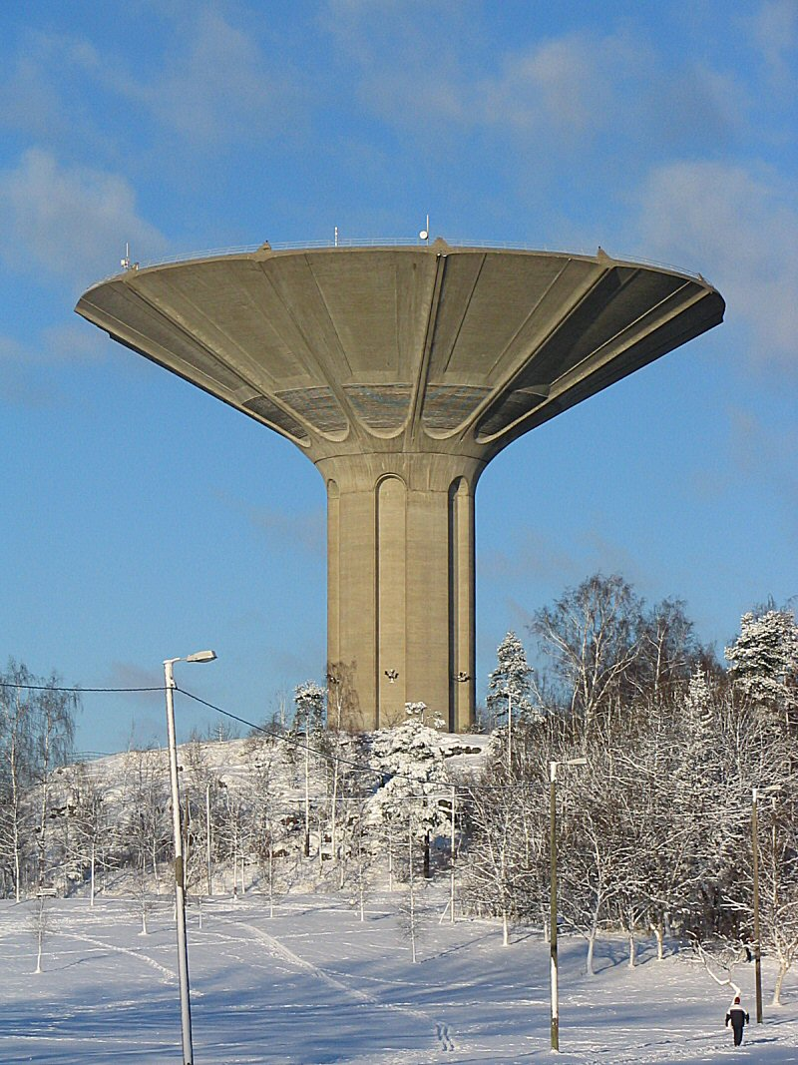
CONICAL BOTTOM

Slide 11
Circular Tanks Resting On Ground
The tank has tendency to increase in diameter due to hydrostatic pressure
This increase in diameter all along the height of the tank depends on the nature of joint at the junction of slab and wall

Slide 12
The tank has tendency to increase in diameter due to hydrostatic pressure
This increase in diameter all along the height of the tank depends on the nature of joint at the junction of slab and wall
Tank with flexible base
Tank with rigid base

Slide 13
When the joints at base are flexible, hydrostatic pressure induces maximum increase in diameter at base and no increase in diameter at top
When the joint at base is rigid, the base does not move
Problems
1)A reinforced concrete dome of 6m base diameter with a rise of 1.25m is to be designed for a water tank. The uniformly distributed load including finishes on come may be taken as 2kN/m2.adopting M20 concrete and grade I steel, design the dome and ring beam. Permissible tensile stress in steel=100N/mm2

Slide 17
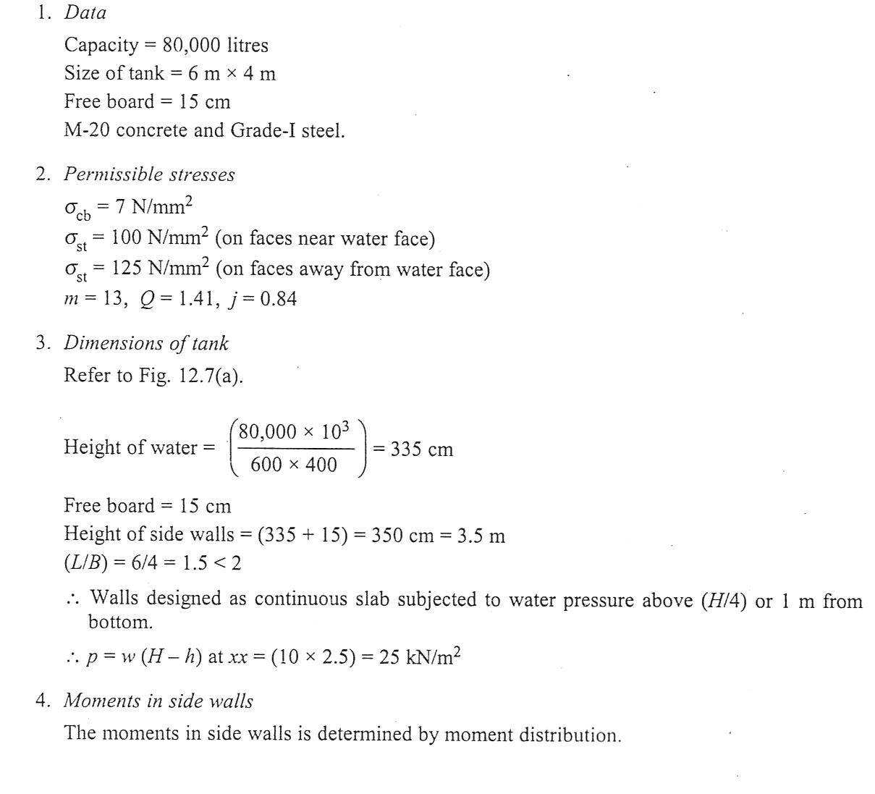
2)A rectangular R.C. water tank with an open top is store 80000litres of water. The inside dimensions of tank may be taken as 6mx4m.the tank rests on walls on all the four sides. Design the side the side walls of the tank using M20 concrete and grade I steel.

Slide 20
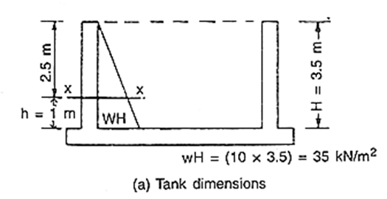
Dimension of the tank

